Slide 1
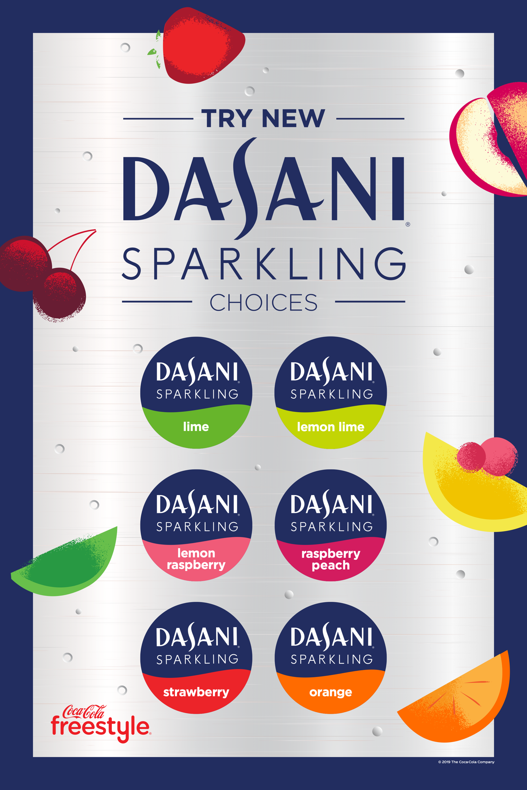
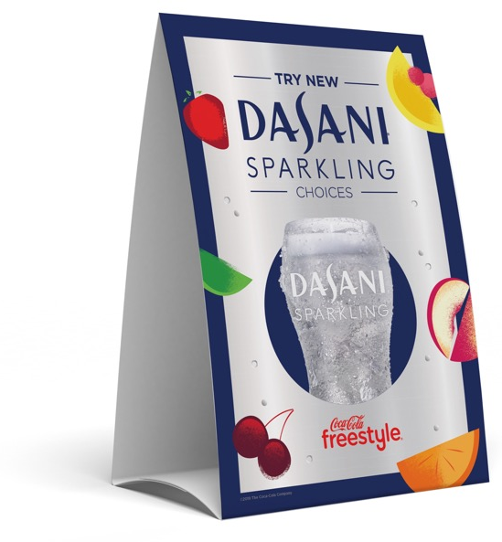
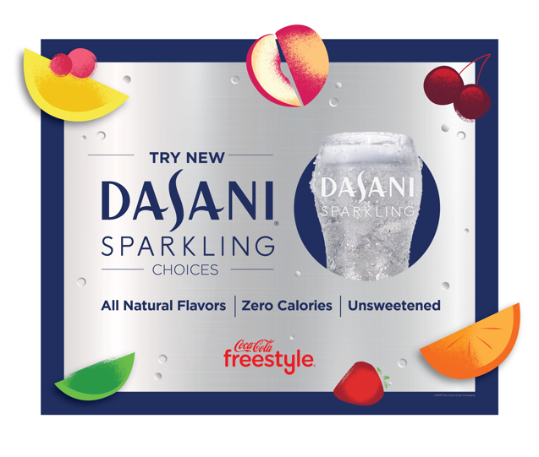
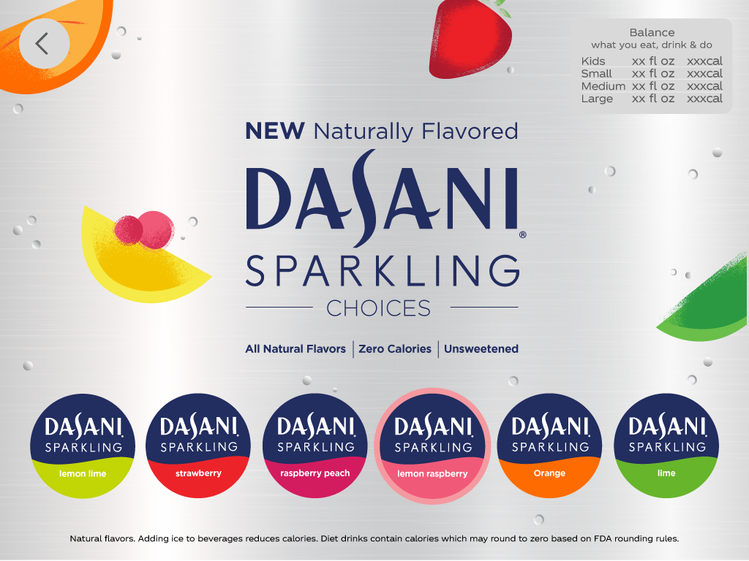
9100
9000
8000
Dasani Sparkling
Goal/Objective: Delight the consumer and drive incremental beverage purchases with the promotion of 5 NEW Dasani Sparkling Choices (flavors)
PROGRAM HIGHLIGHTS:
Promotion Timing: January 1 – January 31
Sparkling Water is BOOMING – especially on CCFS. Volume for Dasani Sparkling Unflavored is +4.2% vs PY and Lemon Lime is +6.1% vs PY
Program will feature Lemon Lime plus 5 NEW choices: Strawberry, Raspberry Peach, Lemon Raspberry, Orange & Lime
The Dasani Sparkling Program will automatically appear on Coca-Cola Freestyle Dispensers
In addition to the Promotion, the 5 new Dasani Sparkling Choices will be featured under the Dasani Sparkling Brand Button as sustaining flavors
A la carte POS available for free – only pay shipping & handling. Limit to 1x of each item per store (except Table Tents)
Confero Mystery Shoppers will be visiting 500 POS ordering locations to track and encourage proper POS execution (opt out deadline 11/12) → Contact Connor Lewis with any questions
Deadline to order POS Kits
11/8/19
NEXT STEPS TO PARTICIPATE:
Contact your Coca-Cola Sales Rep if interested
Notify your customers of Mystery Shops from 1/6 – 1/27
Account Teams can order FREE a la carte POS via CokeCatalog.com by searching “ccfs dasani”
Searchable Coke Catalog Item Codes:
Expected Kit Arrival
12/30/19
Real Estate Sign: 1923889
Table Tent: 1923886
Window Cling: 1923888
Counter Card: 1923887

Slide 2
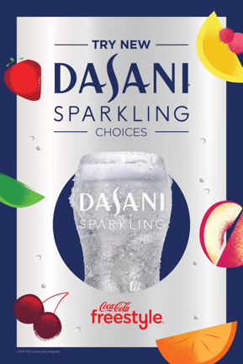
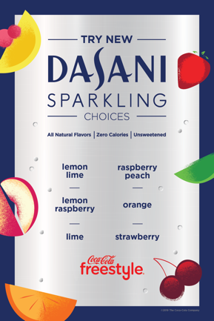
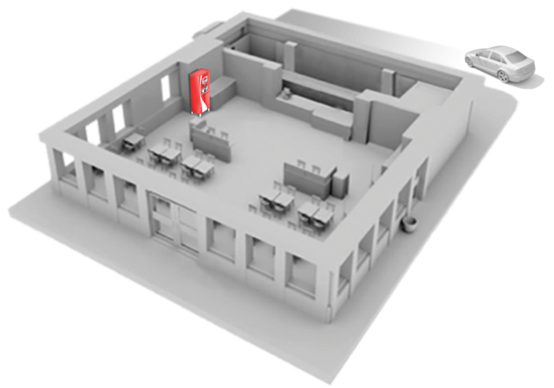
FREE Digital Menu Board creative available on:
www.coca-colafreestyleassets.com UN: ccfs PW: ccfs22
Signage Works!
Capture your customers’ attention with engaging Coca-Cola Freestyle® Dasani Sparkling signage. Research confirms that placing point-of-sale signage at key places around your store drives sales.
Counter Card
Reinforce Dasani Sparkling Choices as customers order
Counter/Drive-Thru Zone
Drive-Thru or Outdoor Sign
Encourage customers to try a new Dasani Sparkling Choice
Table Tent
Provides further details about Dasani Sparkling Choices
Entrance Zone
Window Cling
Promote Dasani Sparkling Choices from afar

