Slide 1
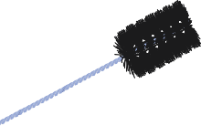
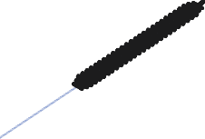
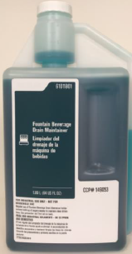
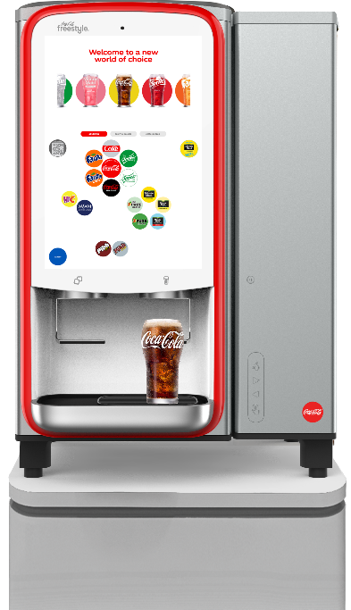
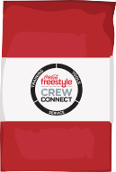
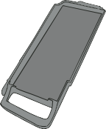
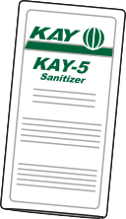
Small Parts Program
Request a small parts order by calling the
Coca-Cola service number 1-800-241-COKE (2653)
Per location, order up to $25 (at no charge) of small parts listed here
Shipping requests other than standard ground transportation may be charged to your outlet
Contact your Coca-Cola representative with any questions about the small parts programs
Nozzle Tip
#144700 | $5.49
Nozzle/Injector Ring Brush
#149326 | $9.28
Key, Product Door
#141343 | $2.17
Ice Chute Cleaning Brush
#143257 | $13.48
Wire Nozzle Brush
#16586 | $0.41
Drain Maintainer
#149053 | $25.00
8 - 1oz. packages
Microfiber Cloth
#127723 | $3.04
Drain Brush
#144925 | $14.37
KAY-5 Sanitizer
#24041 | $1.89
Mesh Cleaning Tool Bag
#150102 | $8.73
Cartridge Tray
#141103 | $2.36
For more information and training resources on Coca-Cola Freestyle, please visit www.ilearnCoca-ColaFreestyle.com
7100
© 2019 The Coca-Cola Company | Coca-Cola Freestyle® 7000 Small Parts | Classified - Confidential | v190322

